Slide 1




IC-LSF 2020
1st International Conference Labma Scientific Fair
Design Plant Disease Detection System Using Deep Learning Convolutional Neural Network
Xosya Salasa
Wais Al Qarni
Trional Novanza
Fahmi Guantara Diasa
Septa Inda
December 13, 2020 Province Yogyakarta

Slide 2
IC-LSF 2020
BACKGROUND
1st International Conference Labma Scientific Fair
Indonesia is an agrarian country
Agriculture by contributing to the 3rd largest GDP
The main problem in agriculture is the development of pests and diseases of crops
Detection and identification of plant diseases are the main factors to prevent and reduce the spread of plant diseases
December 13, 2020 Province Yogyakarta

Slide 3
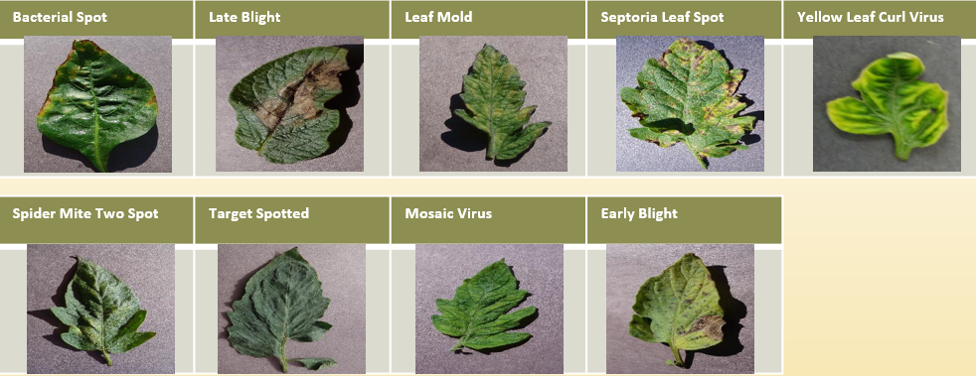
IC-LSF 2020
METHOD
1st International Conference Labma Scientific Fair
Used deep learning methods with the Convolutional Neural Network (CNN) algorithm model
The dataset used comes from PlantVillage with a total of 20,639 leaf image files
December 13, 2020 Province Yogyakarta

Slide 4
IC-LSF 2020
RESULT
1st International Conference Labma Scientific Fair
This research was conducted with 3 epoch iteration tests to find the best accuracy value.
The training data for epoch 50,100, and 150 produces an average model accuracy of 99.38%
The average value of the model loss is 0.019% can also be seen from the testing data results for epoch 50,100, and 150 has an average model of 95.16% and can be seen also from the average value for the loss is 0.20%.
 | Model Accuracy | Model Loss
Training Data | 99,38% | 0,019%
Testing Data | 95,16% | 0,20%
December 13, 2020 Province Yogyakarta

Slide 5
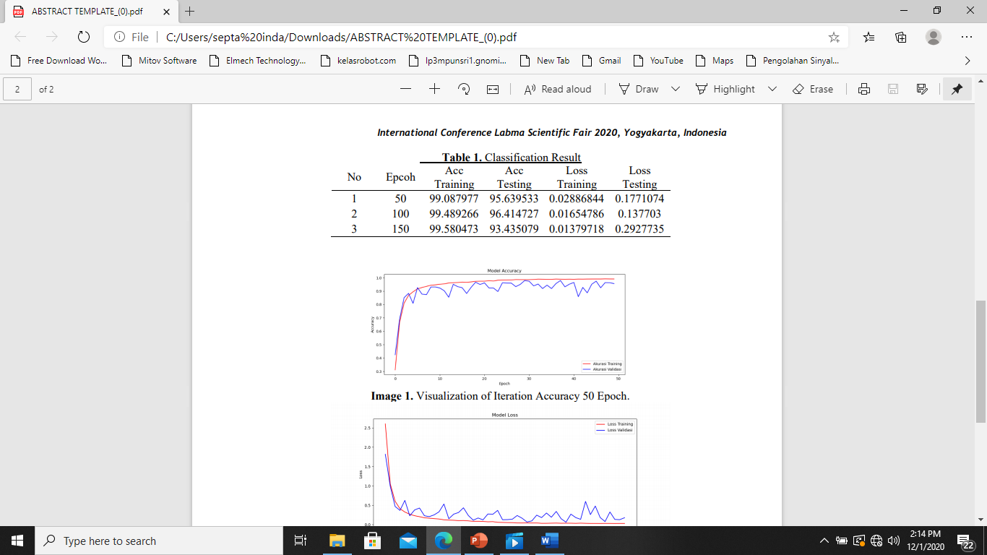
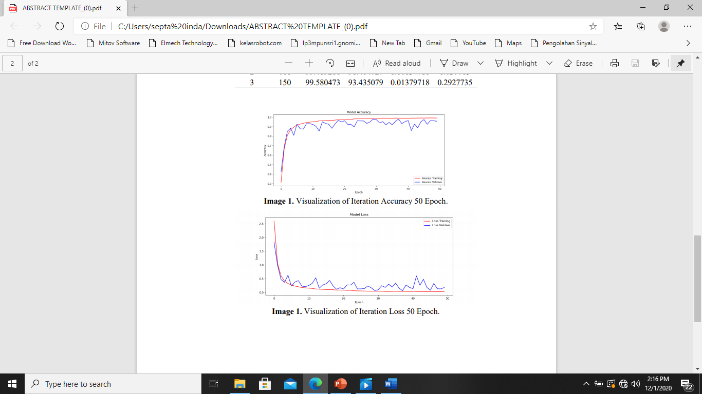

IC-LSF 2020
Classification Result
1st International Conference Labma Scientific Fair
Visualization of Iteration Loss 50 Epoch.
Visualization of Iteration Accuracy 50 Epoch
December 13, 2020 Province Yogyakarta

Slide 6
IC-LSF 2020
CONCLUSIONS
1st International Conference Labma Scientific Fair
Based on the algorithm that applied the resulting training accuracy of 99.58% and the accuracy of testing 96.41% then design this application is useful to accurately detect diseases in plants by using leaf imagery of the plant.
December 13, 2020 Province Yogyakarta

Slide 7
IC-LSF 2020
1st International Conference Labma Scientific Fair
THANK YOU
ANY QUESTION ?
December 13, 2020 Province Yogyakarta

